Slide 1
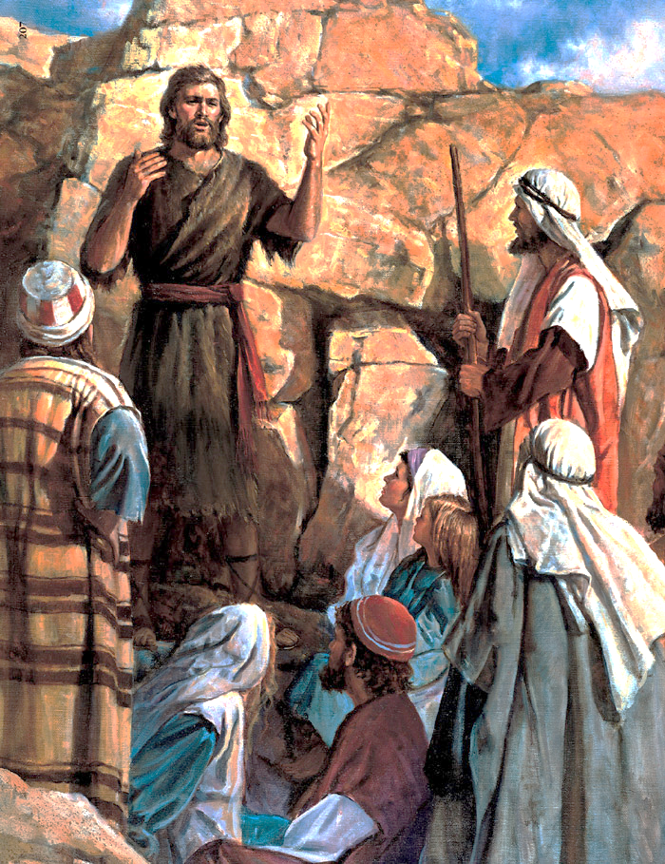
John The Baptist Prepared The Way For Jesus Christ
“Lesson 3: John the Baptist Prepared the Way for Jesus Christ,” Primary 7: New Testament, 9

Slide 2
What is foreordination?
Heavenly Father foreordained us in premortal life when he chose us to do a special work for him on earth.
Being foreordained does not mean that we have to do the work; we still have our freedom or agency, but the opportunity is ours if we choose.

Slide 3
Before class one of you was chosen to do a service.
Please do it now.
Foreordination is like this.

Slide 4
In this lesson we are going to learn about John the Baptist, who was foreordained or chosen to carry out an important mission on earth.
Read aloud the words on your paper.
I am a choice spirit

Slide 5
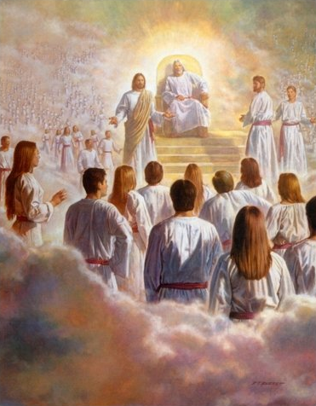
The scriptures we will study explain that John the Baptist was a choice spirit and chosen in the premortal life to prepare the way for Jesus Christ.

Slide 6
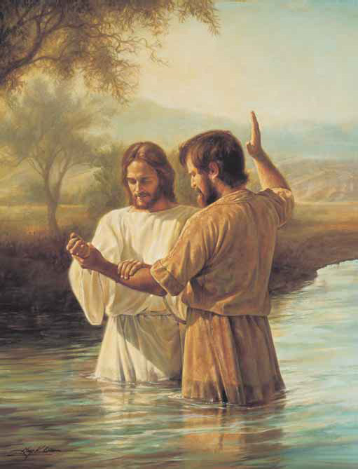
The Story of John the Baptist

Slide 7
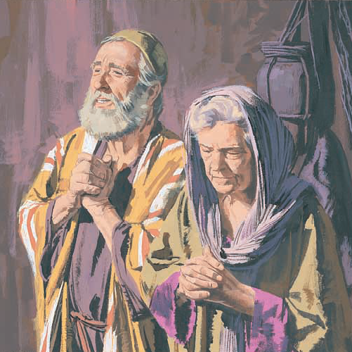
Zacharias and his wife, Elisabeth, were Jews who lived near Jerusalem. They obeyed God’s commandments.
For many years they prayed to have a baby. When they were old, they still had no children.

Slide 8
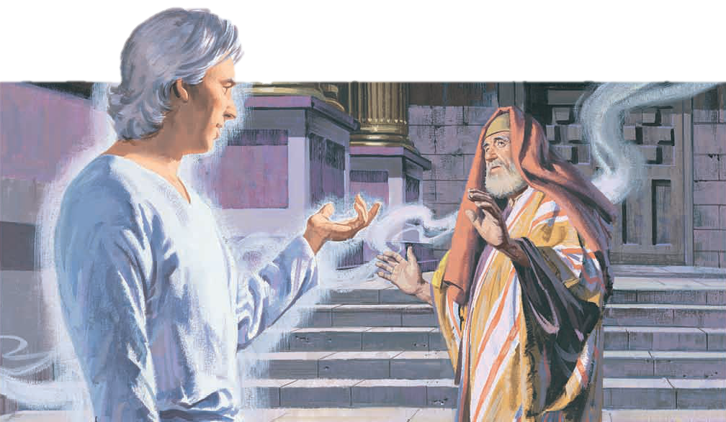
Zacharias was a priest in the temple. One day an angel named Gabriel came to him.
Gabriel said that God would answer Zacharias and Elisabeth’s prayers.
They would have a baby.

Slide 9
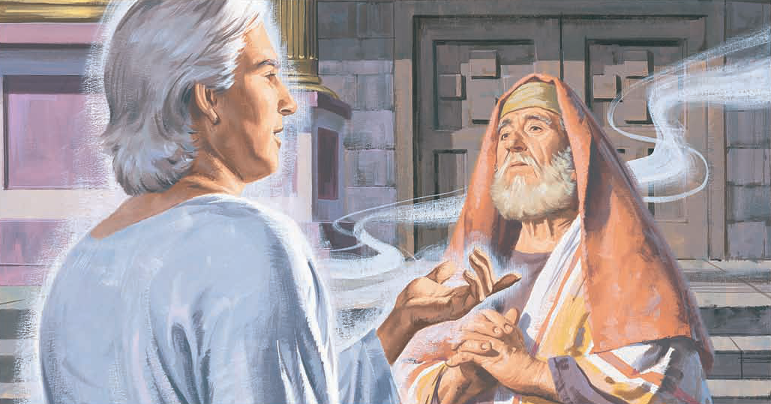
Gabriel said they should name the baby John.
Gabriel said that John would be a righteous prophet of God. He would teach people about Jesus Christ.

Slide 10
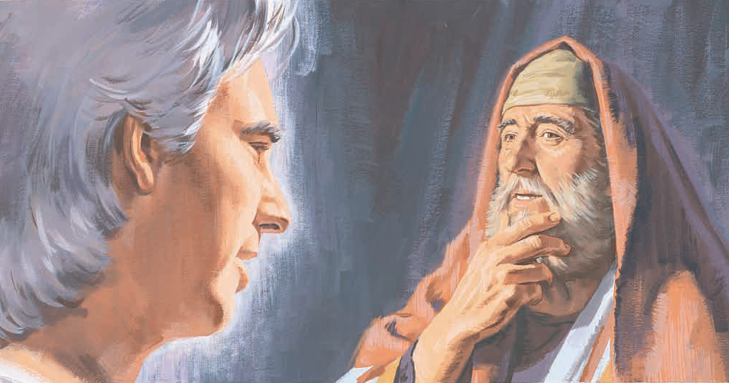
Zacharias did not believe the angel.
Elisabeth was too old to have a baby.
Gabriel said that because he did not believe what God had promised, Zacharias would not be able to talk until John was born.

Slide 11
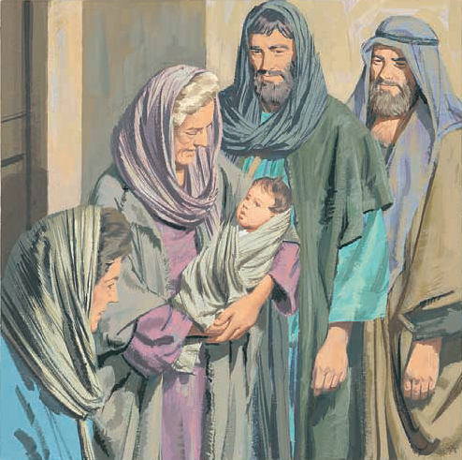
Elisabeth’s son was born. Her friends and family were happy.
They thought that the baby should have the same name as his father, Zacharias.
But Elisabeth said that his name should be John. Everyone was surprised.

Slide 12
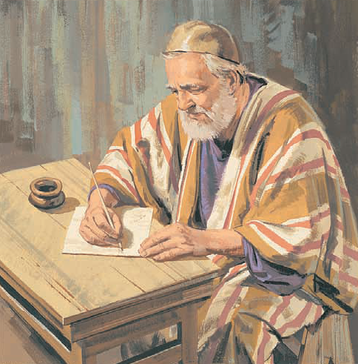
The people asked Zacharias what the baby’s name should be.
Zacharias still could not talk, so he wrote, “His name is John.”

Slide 13
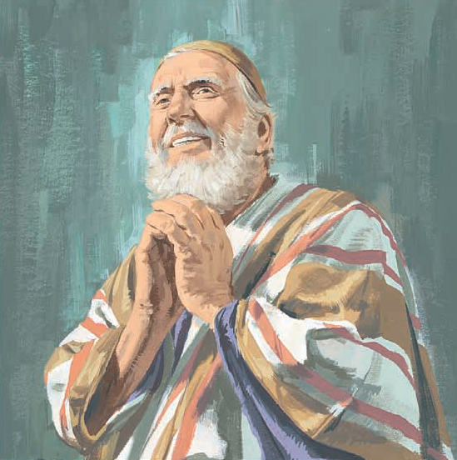
Then Zacharias was able to speak again. He was filled with the Holy Ghost.
He told the people that Jesus Christ would soon be born and that John would prepare the people for Him.

Slide 14
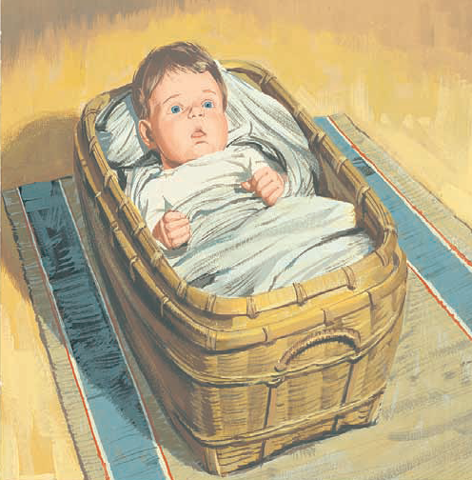
John grew up to become a great prophet. He taught people about Jesus Christ.

Slide 15
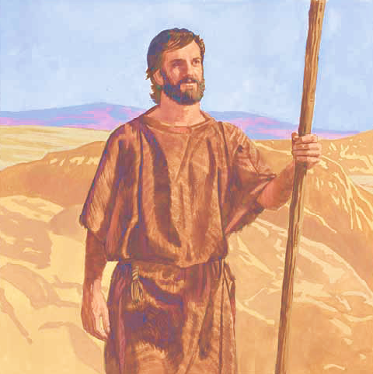

John lived in the desert for many years.
He wore clothes made of camel’s hair and leather.
He ate honey and locusts.

Slide 16
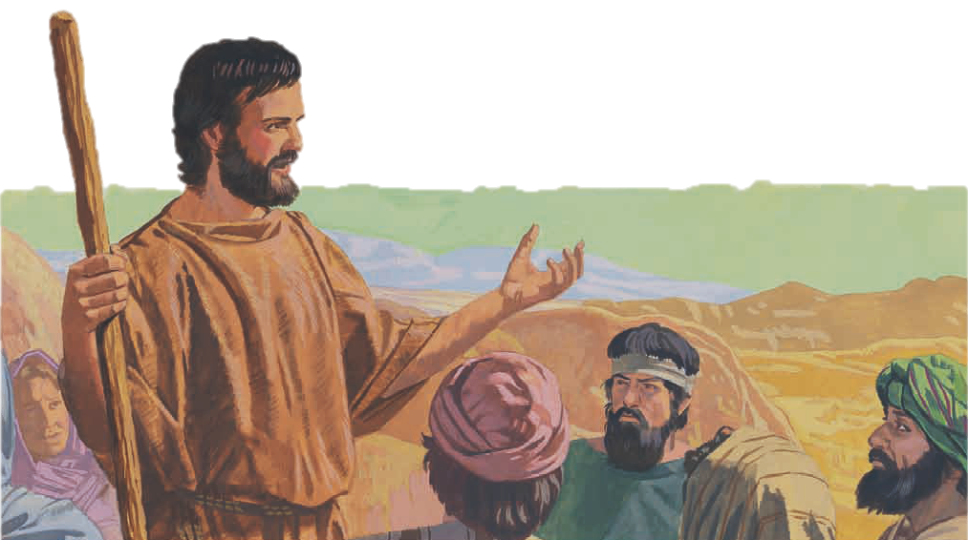
People came from the cities to hear him teach. He was known as John the Baptist.
John the Baptist taught the people about Jesus Christ.

Slide 17
John told them to repent of their sins and be baptized.
He baptized those who repented of their sins.

Slide 18
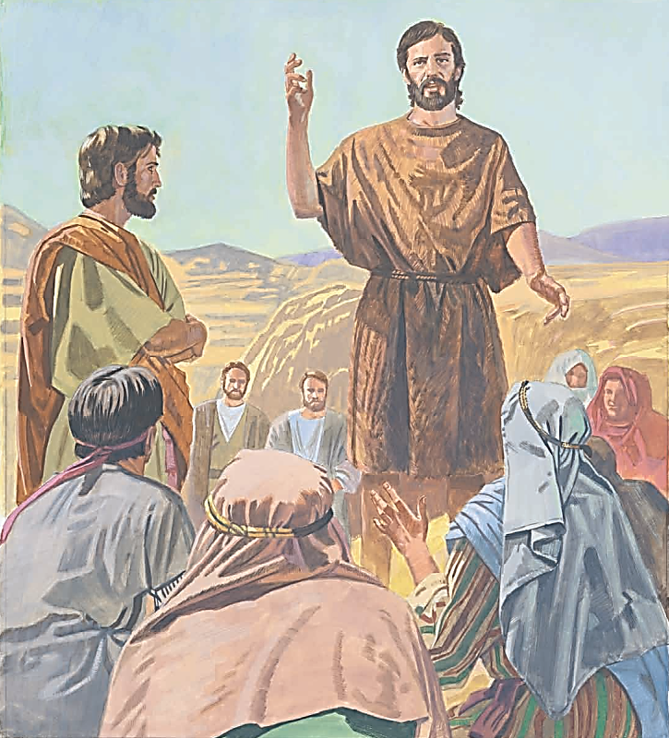
The people asked John how to live better lives. He told them to share with the poor, tell the truth, and be fair to others.
He said that Jesus Christ would soon come.
Jesus would give them the gift of the Holy Ghost.

Slide 19
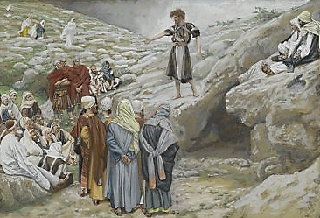
John the Baptist told the people he could baptize them with water, but Jesus Christ would baptize with the Holy Ghost.

Slide 20
Discussion Time!
What do we know about the parents of John the Baptist?
Let’s read Luke 1:5–7
Why was Zacharias not able to speak?
Let’s read Luke 1:18–20

Slide 21
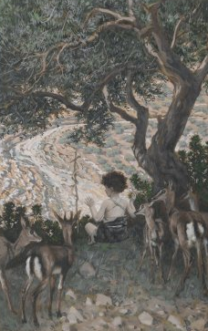
Why did Zacharias and Elisabeth name their son John?
Let’s read Luke 1:13
What do we know about John’s childhood?
Let’s read Luke 1:80 & D&C 84:27–28

Slide 22
What was John the Baptist foreordained to do?
Let’s read Luke 1:15–17, 76–77

Slide 23
How did John the Baptist fulfill his foreordained mission to prepare the way for Jesus Christ?
Let’s read Matthew 3:1–6

Slide 24

Quiz Time!
John the Baptist:
a. Lived in the ________.
b. Was ________ months older than Jesus.
c. Wore clothing made of ________ and ________.
d. Ate ________ and ________.
e. Prepared the way for _________.
Let’s read Luke 1:26–27, 35–36, 76 and Matthew 3:1, 4 for the answers!
Enr. Act. 1

Slide 25
Quiz Time!
John the Baptist:
a. Lived in the ________.
b. Was ________ months older than Jesus.
c. Wore clothing made of ________ and ________.
d. Ate ________ and ________.
e. Prepared the way for _________.
Let’s read Luke 1:26–27, 35–36, 76 and Matthew 3:1, 4 for the answers!
wilderness
six
camel hair
leather
locusts
honey
Jesus Christ
Enr. Act. 1

Slide 26
Even though John the Baptist lived a simple, humble life in the wilderness, he faithfully fulfilled his mission and prepared the way for Jesus Christ.
Enr. Act. 1

Slide 27

Just as John the Baptist was a choice spirit chosen to help build Heavenly Father’s kingdom by preparing the way for Jesus Christ, we are choice spirits chosen to help build Heavenly Father’s kingdom by helping people know more about Jesus Christ.

Slide 28
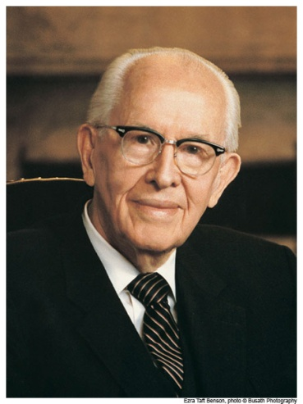
President Ezra Taft Benson said:
“You are choice spirits, many of you having been held back in reserve for almost 6,000 years to come forth in this day, at this time, when the temptations, responsibilities, and opportunities are the very greatest” (in Conference Report, Oct. 1977, p. 43; or Ensign, Nov. 1977, p. 30).

Slide 29
How does it make you feel to know that Heavenly Father knows you personally and chose you to come to earth at this time?

Slide 30
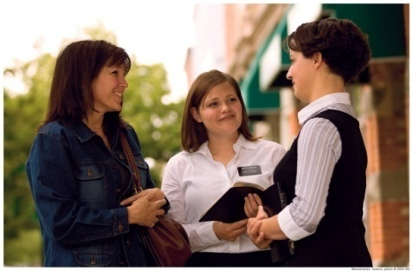
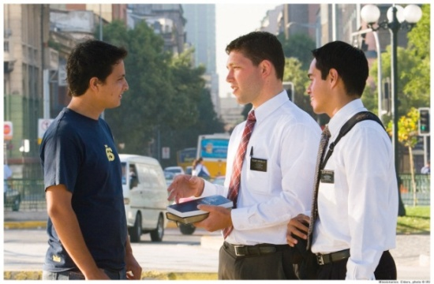



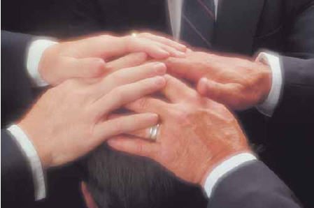
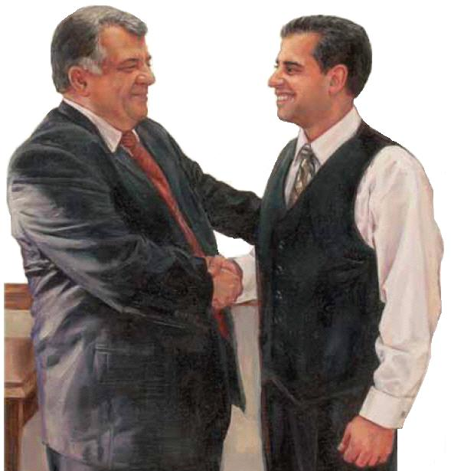

What are some of the things we might have been foreordained to do to help build Heavenly Father’s kingdom?

Slide 31

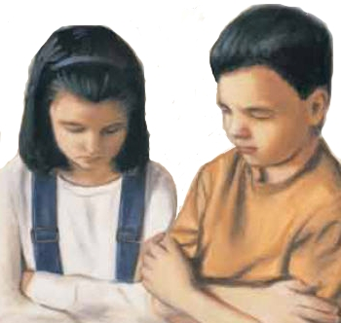
How can you find out what Heavenly Father wants you to do here on earth?
Pray about decisions, listen to the Spirit.

Slide 32
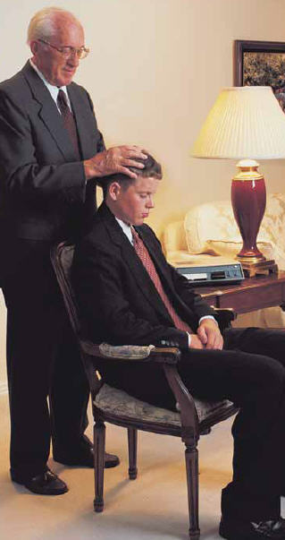
Heavenly Father has also given us the opportunity to receive patriarchal blessings from a stake patriarch when we are old enough.
Patriarchal blessings often indicate what callings we might receive or what Heavenly Father wants us to do with our lives.

Slide 33
How can you prepare yourself to do what Heavenly Father wants you to do?

Slide 34
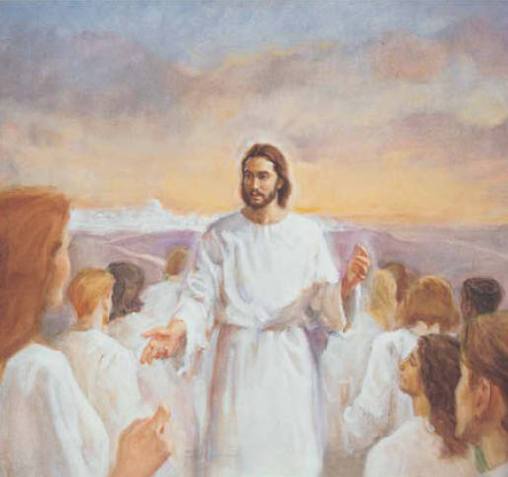
Let’s read these scriptures to find out who else was foreordained for their earthly mission
Enr. Act. 2

Slide 35
Jeremiah 1:5 —Jeremiah
1 Nephi 11:18 —Mary, the mother of Jesus (vision given to Nephi)
Ether 3:14 —Jesus Christ
D&C 138:53, 55 —Joseph Smith & others
Abraham 3:23 —Abraham
Enr. Act. 2

Slide 36
I bear testimony that just as John the Baptist was foreordained to prepare the way for Jesus Christ and be a witness for him, so each of us was foreordained to our mission on earth.
I know the importance of living the gospel and being worthy to do whatever Heavenly Father foreordained us to do.

Slide 37
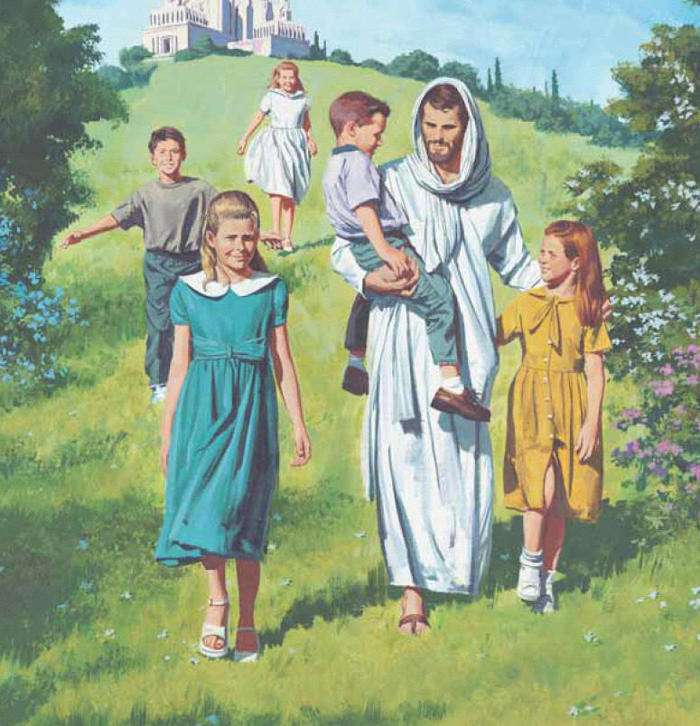
Images and clipart are from lds.org, sugardoodle.net, Microsoft Office, and other websites indicating the images were in the public domain. The hymn, lesson and scripture story are from lds.org
Please do not use this presentation for commercial use. Feel free to alter the presentation for use in church or home to suit personal preference.
This presentation is intended to supplement, not replace, the lesson manual and scriptures. Teachers should refer to the manual, scriptures and other resources when preparing and conducting the lesson.

